Slide 1
Effects of time delay on the performance of a deep sea welding task
Group 11
Jannick van Buuren, Henk Jekel, Anna Marbus
Notes:
Effect of time delay on the performance of a deep sea welding task
Group 11
Yannick van Buuren (4444043)
Henk Jekel (5609593)
Anna Marbus (4437381)

Slide 2
Introduction
Introduction
Methods
Discussion
Research question
Results
Conclusion
Deep sea welding task is dangerous
Exposed to dangerous pressure changes
Highest fatality rate of any occupation [1]
Make use of teleoperated robot
Safer option
Welding from a distance
Map motion from user to welding robot
Problem teleoperated robot
Time delay
Notes:
Clear overview of context
Deep sea welding tasks have highest fatality rate of any occupation.
Would be beneficial to introduce teleoperation to overcome these safety issues
By means of a teleoperated robot, user’s motion is mapped to welding robot → welding can be done from a distance
Safer option
Rationale
Teleoperated systems include time delay
Time delay can be disastrous
We found it interesting to explore the effects of time delay on a teleoperated deep sea welding task

Slide 3
Research question
Introduction
Methods
Discussion
Research question
Results
Conclusion
How does time delay affect performance of a teleoperated robot arm in a 2D environment simulating deep sea oil welding tasks?
Notes:
Research question
How does time delay affect performance of a teleoperated robot arm in a 2D environment simulating deep sea oil welding tasks?

Slide 4
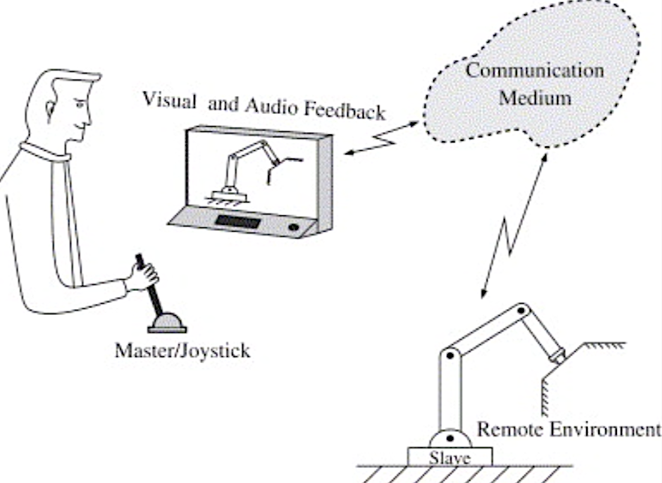
Methods
Unilateral system [2]
Participants should follow a reference trajectory
Reference trajectory resembles welding motion
Sea wave perturbations
Participants are visually perturbated
No haptic feedback included
Introduction
Methods
Discussion
Research question
Results
Conclusion
Notes:
Clear description of the used techniques
The used system is a unilateral teleoperated system
Position of the user is send to the device
User is not able to feel anything
Sea wave perturbations are shown on the screen
No haptics included

Slide 5
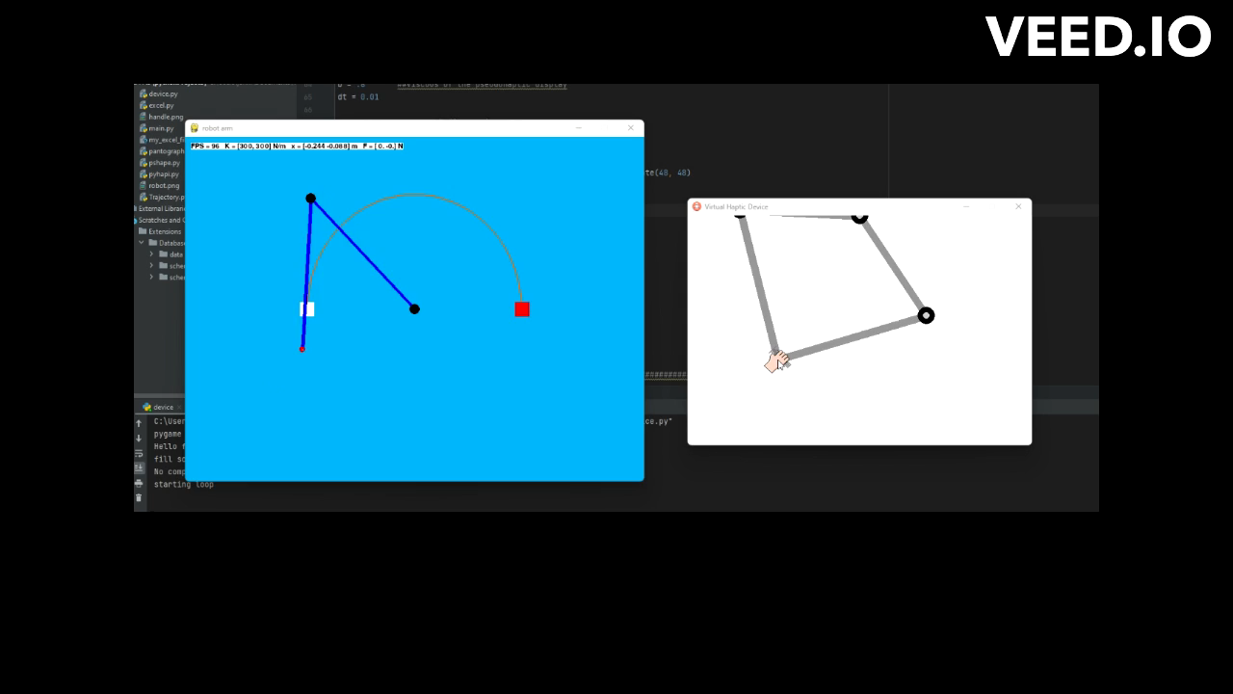
Methods
Introduction
Methods
Discussion
Research question
Results
Conclusion
Notes:
Informative illustrations of the experimental task
Add screenshot of UDP setup
Short video illustrating
Reference trajectory
Wave perturbations

Slide 6
Methods
10 participants
Different amounts of time delay in queue space
1
15
30
45
60
Trials are repeated 5 times
Use performance metric
Mean absolute error
Task completion time
Introduction
Methods
Discussion
Research question
Results
Conclusion
Notes:
Clear description of protocol
10 participants are included in this project (5F and 5M)
To exclude effect of age difference, only include participants aged between 18 – 28
Participants had to carry out 5 trials and were asked to repeat trials 5 times
Mean absolute deviation from reference trajectory and task completion time are reported (performance metrics)

Slide 7
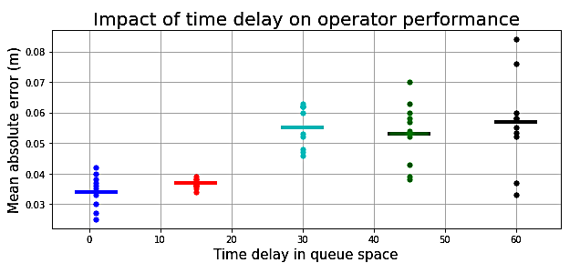
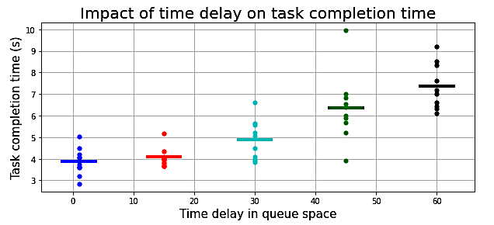
Results
Mean absolute error
Task completion time
Introduction
Methods
Discussion
Research question
Results
Conclusion
Notes:
Clear description of data analysis
Performance metrics 1: mean absolute deviation from reference trajectory
For each trial, sum of absolute deviation is reported
Sum of absolute deviation is averaged across trials
Sums of absolute deviation is averaged over subjects
Performance metrics 2: task completion time
Task completion time is averaged across trials
Task completion time is averaged across subjects

Slide 8
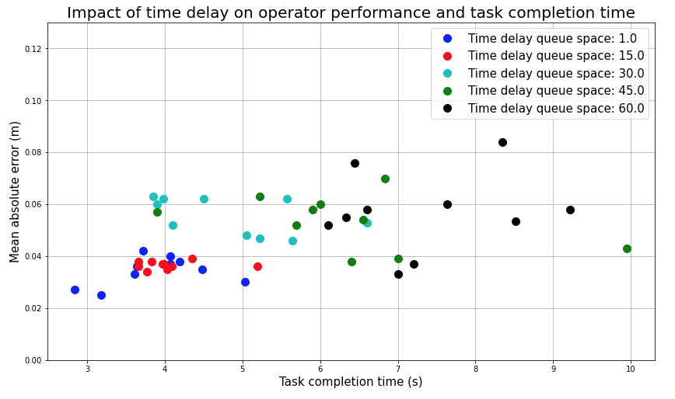
Results
Introduction
Methods
Discussion
Research question
Results
Conclusion

Slide 9
Conclusion
Introduction
Methods
Discussion
Research question
Results
Conclusion
How does time delay affect a performance of a teleoperated robot arm in a 2D environment simulating deep sea oil welding tasks?
Increased time delay → increased mean absolute error
Increased time delay → increased task completion time
Notes:
Interpretation of the results
Increased time delay → increased mean absolute deviation
Increased time delay → increased task completion time

Slide 10
Discussion
Introduction
Methods
Discussion
Research question
Results
Conclusion
Include more participants
Identify outliers
Explore effects of training
Look at learning curves
Look at transfer
Explore effects of reference trajectory shape
Shape may be learned by participants
Notes:
Actionable recommendations
Include more participants to identify outliers
We did not incorporate training
May be interesting to explore effects of training
Learning curve/transfer
We used a single reference trajectory shape
What happens when we change shape?
Does it impact our outcomes?

Slide 11
Bibliography
Barker, A. (2023, February 09). The dangers of underwater welding. Retrieved March 30, 2023, from https://www.getgordon.com/blog/underwater-welding-dangers/
Peter F. Hokayem, AbstractThis survey addresses the subject of bilateral teleoperation, Anderson, R., Desoer, C., Eusebi, A., Ferrell, W., . . . Imaida, T. (2006, September 18). Bilateral teleoperation: An historical survey. Retrieved March 31, 2023, from https://www.sciencedirect.com/science/article/abs/pii/S0005109806002871

Slide 12
Questions

